Slide 1
Software Architecture and Quality Attributes

Slide 2
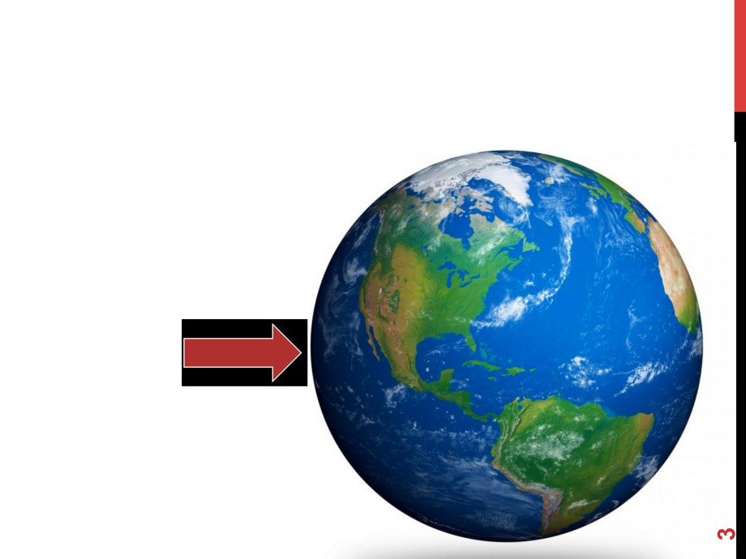
INTRODUCTION
Nowaday…
Software
Systems

Slide 3
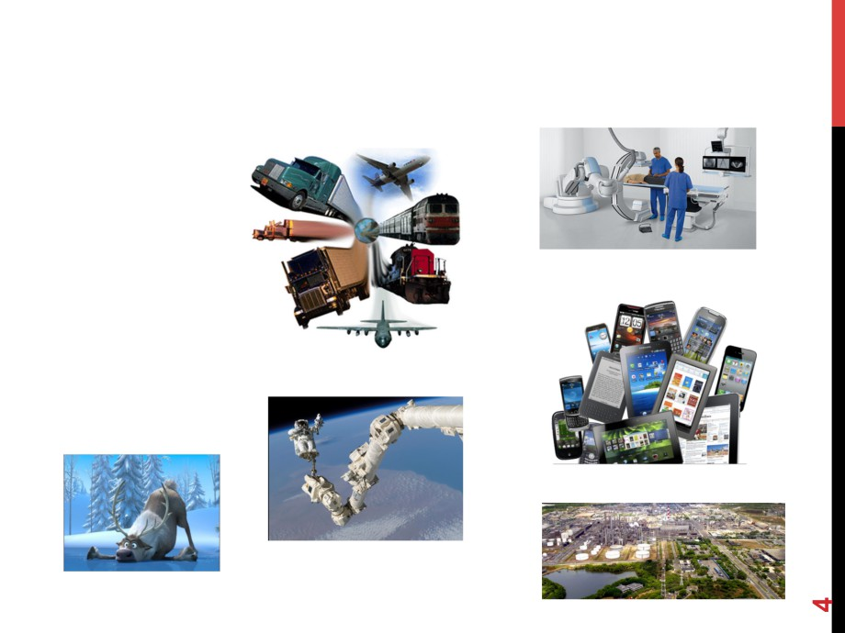
INTRODUCTION
http://www.siemens.co.za/
Application
Domains
http://www.2x.com/
http://jquerymobile.com/
http://www.nasa.gov/
http://disney.com
http://www.coficpolo.com.br/

Slide 4

INTRODUCTION
Changes in the
• Complexity
• Diversity
• Scope
• Size
of software systems.

Slide 5
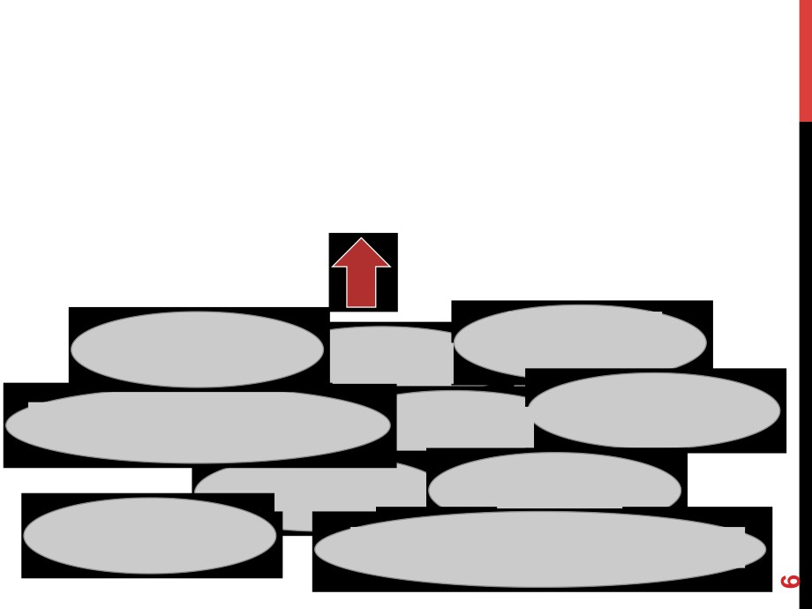
INTRODUCTION
Software Systems
Techniques Methods
Processes
Approaches
Tools & Environments
Artifacts
People Activities
Technologies
Data, Information & Knowledge

Slide 6
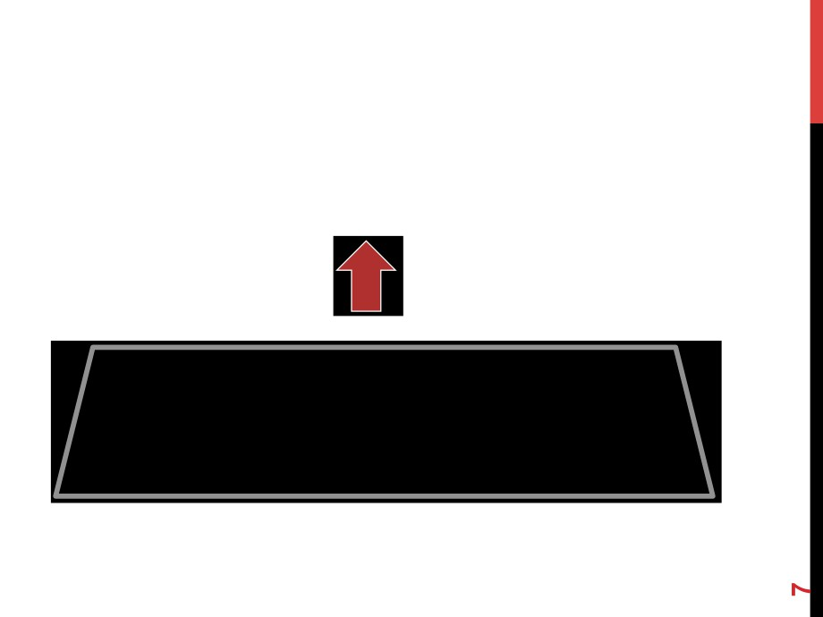
INTRODUCTION
Software Systems

Slide 7
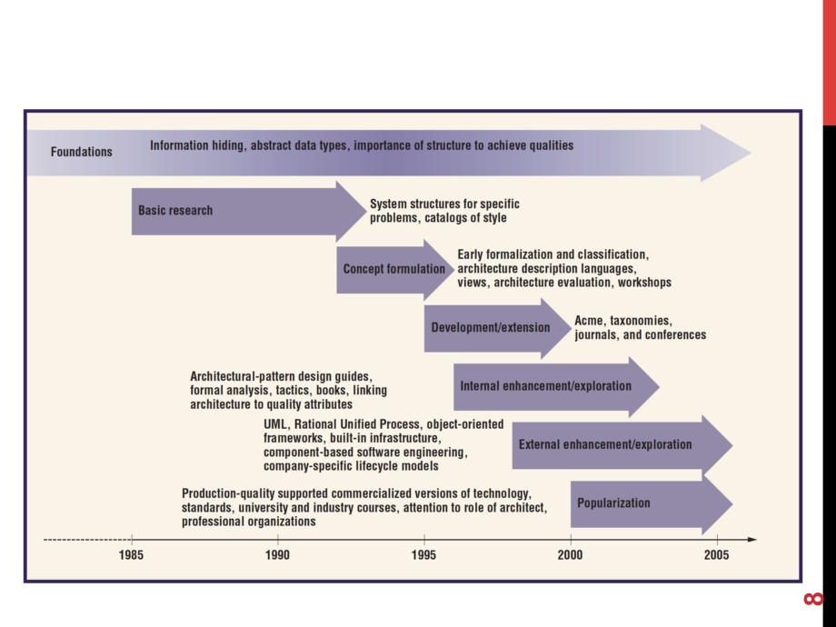
BRIEF HISTORY ON SOFTWARE ARCHITECTURE
[Shaw, 2006]

Slide 8

HISTORY: ORIGIN OF THE FIELD “SOFTWARE ARCHITECTURES”
1992 - Dwayne Perry and Alexander Wolf “Foundations for the Study of Software Architectures” in Software Engineering Notes
1993 - David Garlan and Mary Shaw “An Introduction to Software Architecture” in Advances in Software Engineering and Knowledge Engineering
1994 - Special Issue on Software Architecture in IEEE Transactions on Software Engineering
1995 - Special Issue on Software Architecture in IEEE Software
2006 - Special Issue on Software Architecture in IEEE Software (in the 10th anniversary of the 1995 special issue).

Slide 9

TODAY - VERY ACTIVE AND ESTABLISHED FIELD
• Dedicated conferences/symposiums/workshops:
• WICSA (Working Conference on Software Architecture)
• ECSA (European Conference on Software Architecture)
• QoSA (Quality of Software Architecture)
• SBCARS (Brazilian Symposium on Components, Architectures and Reuse)
• Workshops associated with most software engineering conferences
• Permanent Section on Architecture, e.g., in JSS
• http://www.journals.elsevier.com/journal-of-systems-and-software/ call-for-papers/special-issue-on-sustainability-and-longevity-of- systems/
• Major buzzwords and trends related to the architectural field: SOA, MDA, IoT, ADL, UML, …

Slide 10
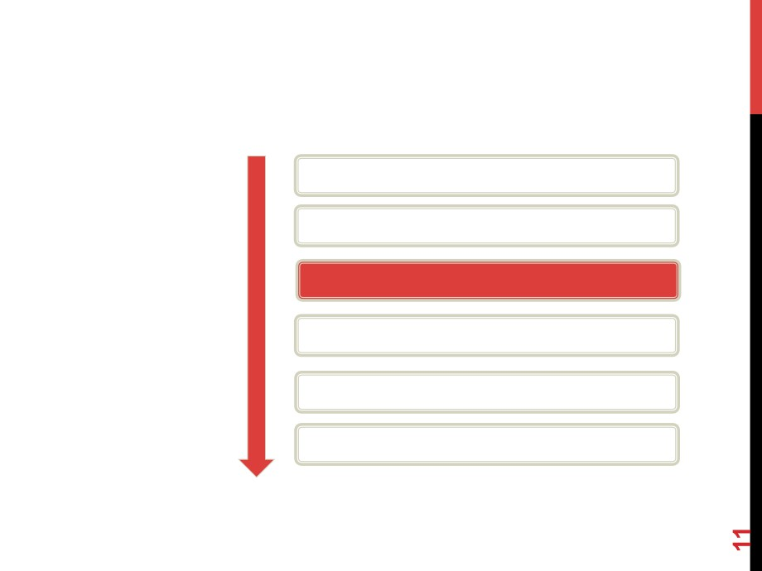
ROLE OF SOFTWARE ARCHITECTURE
User Model Requirements
Problem Space
Architecture
Design
Code Executable
Solution Space
[Shaw, 2006]

Slide 11

SEVERAL DEFINITIONS
• “The fundamental organization of a system embodied in
its components, their relations to each other, and to the environment, and the principles guiding its design and evolution.” [ISO/IEC/IEEE 42101]
• “The software architecture of a program or computing
system is the structure or structures of the system, which comprise software elements, the externally visible properties of those elements, and the relationships among them.” [Clements, 2003]

Slide 12

SEVERAL DEFINITIONS
• “A software system’s architecture is the set of principal
design decisions made about the system”. [Taylor, 2009]
• “Architecture is what you get before you start adding
detail to the design.” [Clements et. Al]
• More than 10 definitions widely adopted.
• Discussion on software architecture definitions:
• http://www.sei.cmu.edu/architecture/start/glossary/published.cfm

Slide 13

QUALITY X SOFTWARE ARCHITECTURE
•
Software Architecture
•
Backbone for any successful software-intensive system
•
Fundamental role in determining the system quality
• ISO/IEC 25000:2014 (Systems and software engineering --
Systems and software Quality Requirements and Evaluation (SQuaRE) -- Guide to SQuaRE)
• IMPORTANT: Trade off among quality attributes!!

Slide 14
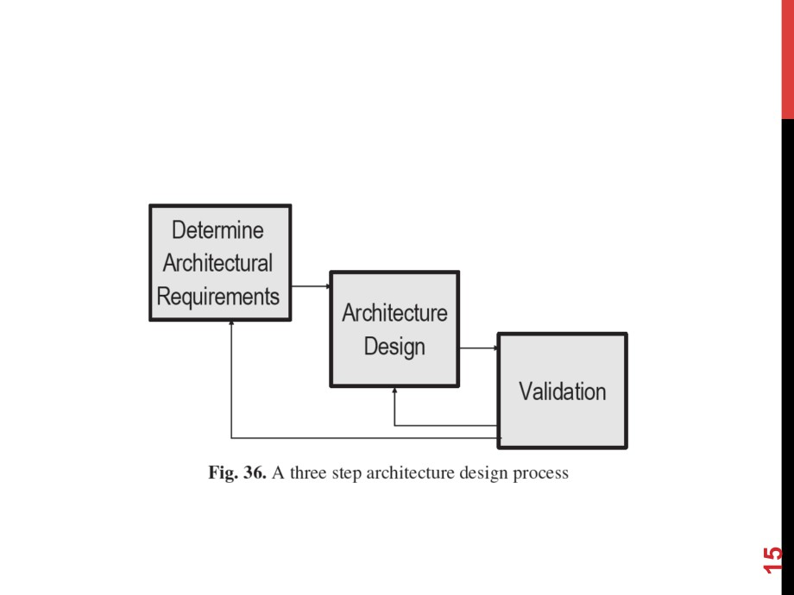
ARCHITECTURE DESIGN PROCESS
[Gorton 2006]

Slide 15
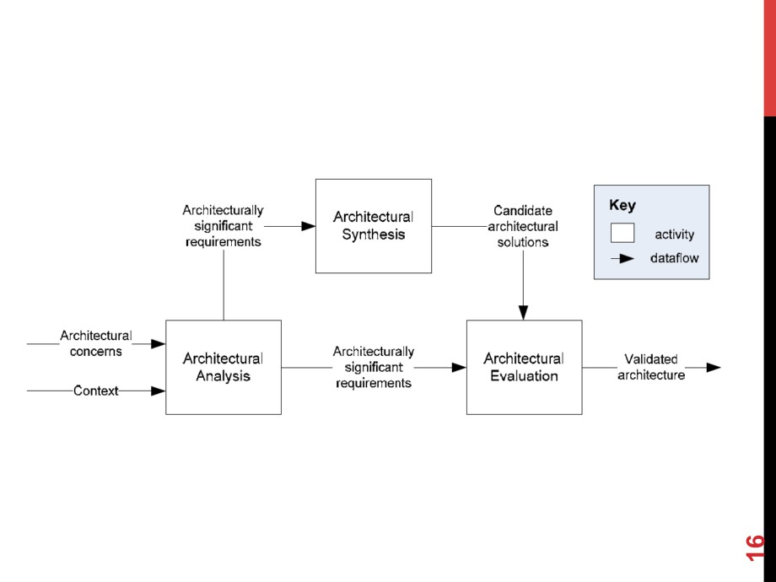
GENERAL ARCHITECTURING PROCESS
[Hofmeister, 2005]

Slide 16

ARCHITECTURAL ANALYSIS
• Architectural analysis articulates architecturally significant
requirements (ASRs) based on the architectural concerns and context.
• Example of ASDs:
•
A typical architecture requirement concerning reliability of
communications is:
• “Communications between components must be
guaranteed to succeed with no message loss”

Slide 17
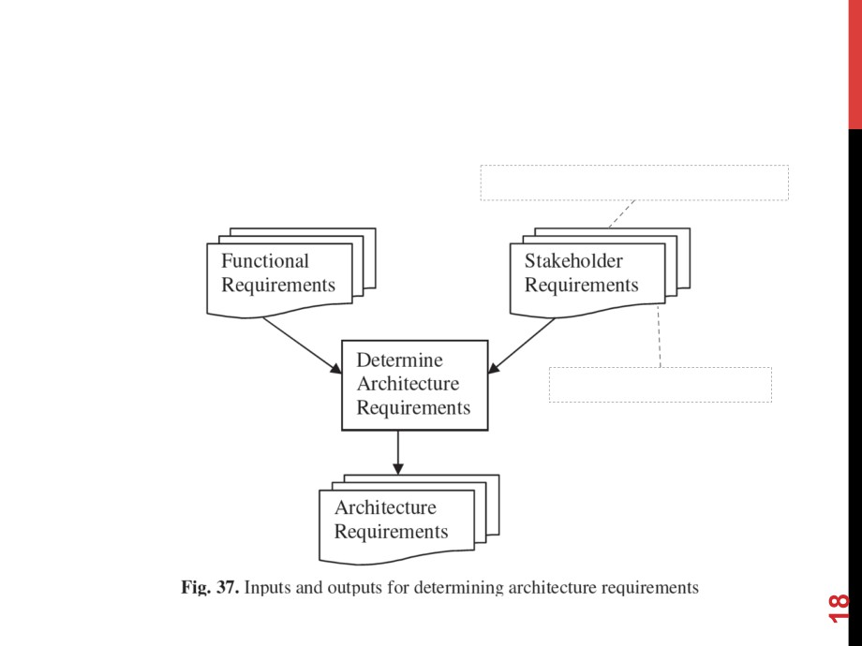
ARCHITECTURAL ANALYSIS
Quality attributes
Constraints
[Gorton 2006]

Slide 18

ARCHITECTURAL SYNTHESIS
• Architectural synthesis results in candidate architectural solutions
that address these requirements.
•
ISO/IEC 42010 (its previous version IEEE 1471)
•
provide a widely accepted conceptual definition of
architectural views, viewpoints and models
•
Architectural/design decision
•
Radar of practitioners and researchers since the early days of
software architecture.
•
Architecture patterns
•
support design of the entire system and dictate a particular
high-level modular decomposition of the system.
•
Use of Architectural Description Languages (ADL)
•
Formal or semi-formal

Slide 19
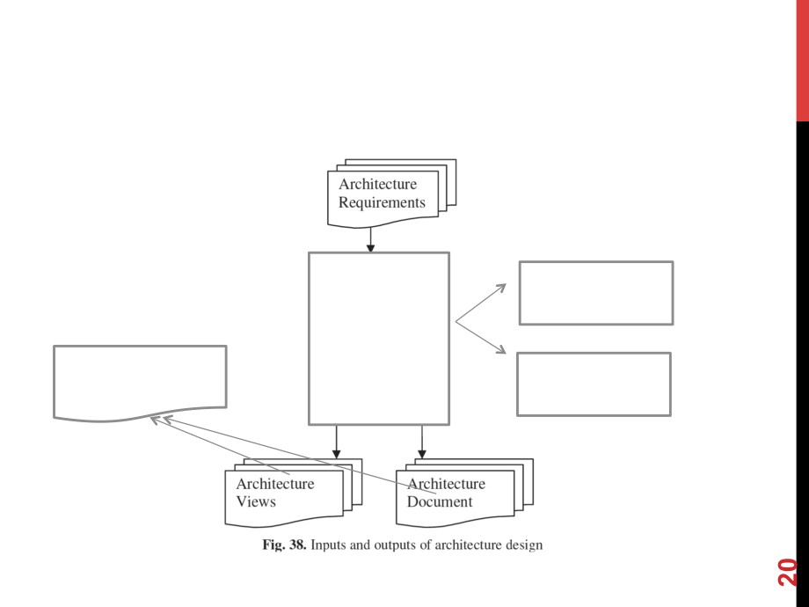
ARCHITECTURAL SYNTHESIS
Selection of
Architectural Patterns
Architecture Design
Architecture
Selection of
Documentation
Architectural
Views
[Gorton 2006]

Slide 20

ARCHITECTURAL EVALUATION
• Architectural evaluation ensures that the architectural decisions
used are the right ones.
• Architecture reviews (or evaluations) are independent
examinations of the software architecture to identify potential architecture problems.
• Architectures are not inherently good or bad, they are only well-
suited or not with respect to a particular set of goals.
Architecture Evaluation
Checks
Architectural-significant decisions Against
Architectural-significant requirements

Slide 21

ARCHITECTURAL EVALUATION
•
Examples:
•
Scenario-Based Architecture Analysis Method (SAAM)
•
Architecture Tradeoff Analysis Method (ATAM)
•
Active Reviews for Intermediate Design (ARID)
•
Architecture-Level Modifiability Analysis (ALMA)
•
Architecture-Level Prediction of Software Maintenance
(ALPSM)
•
Scenario-Based Architecture Reeingineering (SBAR)
•
Design Decision Architecture Review Method (DCAR)
•
…

Slide 22

REFERENCE ARCHITECTURE
• "A reference architecture refers to an architecture that encompasses the knowledge about how to design concrete architectures of systems of a given application domain; therefore, it must address the business rules, architectural styles (sometimes also defined as architectural patterns that can also address quality attributes in the reference architecture), best practices of software development (for instance, architectural decisions, domain constraints, legislation, and standards), and the software elements that support development of systems for that domain. All of this must be supported by a unified, unambiguous, and widely understood domain terminology.” [Nakagawa, 2011]

Slide 23

STATE OF THE ART/RESEARCH
•
Sustainability of software architectures
•
Variability in software architectures
•
Software architecture for SoS, CPS, CES,…
•
Multi Software Product Line (MSPL)
•
MSLP for SoS, CPS, …
•
Reference architectures
•
Building process
•
Variability
•
Sustainability
•
…

